Slide 1
Unit-3 Inheritance,Interface and Package Marks-12
CO2-Applay Concept of inheritance for code reusability.

Slide 2
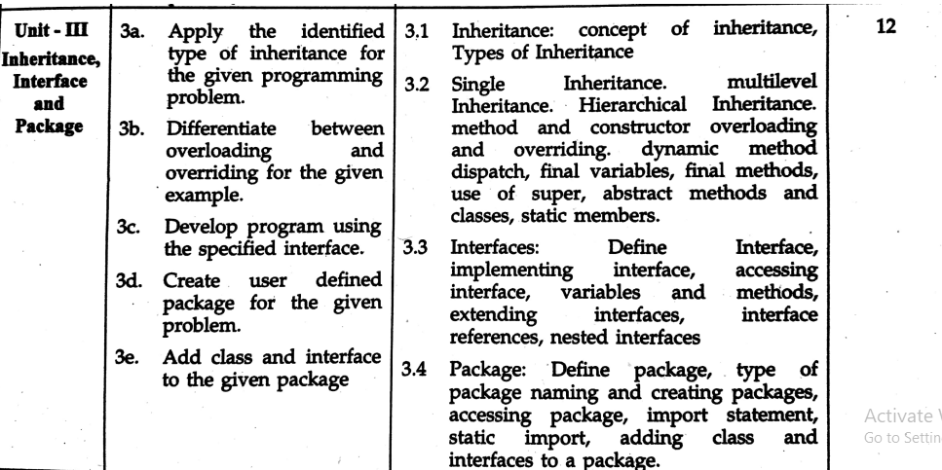

Slide 3

Types of Inheritance
1) Single inheritance
Single level inheritance is that in which there is only one super class and one sub class.
Ex

Slide 4
Syntax
class superclass
{
body
}
class subclass extends superclass
{
body
}

Slide 5
class A
{
void showbase()
{
System.out.println("this is a super class");
}
}
class B extends A
{
void showderived()
{
System.out.println("This is sub class");
}
}
class single2
{
public static void main(String args[])
{
//A ob=new A();
//ob.showbase();
//ob.showderived();
B obj=new B();
obj.showbase();
obj.showderived();
}
}

Slide 6
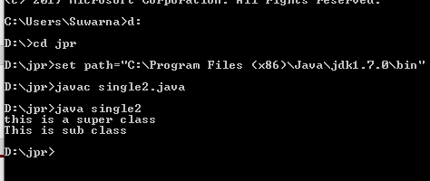

Slide 7
class A
{
A()
{
System.out.println("this is a super class");
}
}
class B extends A
{
B()
{
System.out.println("This is sub class");
}
}
class single2Con
{
public static void main(String args[])
{
B obj=new B();
}
}

Slide 8


Slide 9
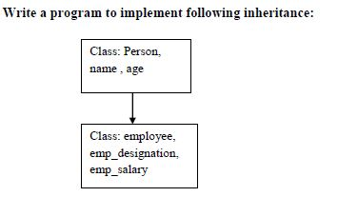
Example of Single Inheritance

Slide 10
import java.util.*;
class person
{
String name;
int age;
person(String n,int a)
{
name=n;
age=a;
}
}
class employee extends person
{
String emp_desg;
int emp_sal;
employee(String n,int a,String p,int q)
{
super(n,a);
emp_desg=p;
emp_sal=q;
}
void display()
{
System.out.println("Name="+name+"\tAge="+age);
System.out.println("Desig="+emp_desg+"\tsal="+emp_sal);
}
}

Slide 11
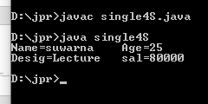
class single4S
{
public static void main(String args[])
{
employee e=new employee("suwarna",25,"Lecture",80000);
e.display();
}
}

Slide 12
import java.util.*;
class person
{
Scanner sc=new Scanner(System.in);
String name;
int age;
void getperson()
{
System.out.println("Enter name of employee");
name=sc.next();
System.out.println("Enter age of employee");
age=sc.nextInt();
}
}
class employee extends person
{
String emp_desg;
int emp_sal;
void getemployee()
{
System.out.println("Enter designation of employee");
emp_desg=sc.next();
System.out.println("Enter sal of employee");
emp_sal=sc.nextInt();
}
void display()
{
System.out.println("Name="+name+"\tAge="+age);
System.out.println("Desig="+emp_desg+"\tsal="+emp_sal);
}
}

Slide 13
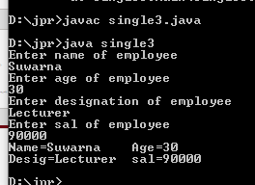
class single3
{
public static void main(String args[])
{
employee e=new employee();
e.getperson();
e.getemployee();
e.display();
}
}

Slide 14
class single
{
int a,b,c;
void show()
{
System.out.println("b in super class"+b);
}
}
class single1 extends single
{
int a;
single1(int p,int q)
{
a=p;
super.b=q;
}
void show()
{
System.out.println("b in super class"+super.b);
System.out.println("a in sub class"+a);
}
}
public static void main(String args[])
{
single1 obj=new single1(1,5);
obj.show();
}
}

Slide 15
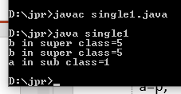

Slide 16
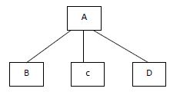
2) Hierarchical inheritance
Hierarchical inheritance is that in which there is only one super class and many sub classes.

Slide 17
Synatx
class A
{
}
class B extends A
{
}
class C extends A
{
}
class D extends A
{
}

Slide 18
class A
{
void showbase()
{
System.out.println("This is A class");
}
}
class B extends A
{
void showderived1()
{
System.out.println("This is B class");
}
}
class C extends A
{
void showderived2()
{
System.out.println("This is c class");
}
}
class Hierarchical
{
public static void main(String args[])
{
B obj1=new B();
C obj2=new C();
obj1.showbase();
obj1.showderived1();
obj2.showderived2();
}
}

Slide 19
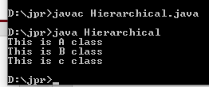

Slide 20
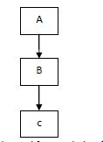
3)Multilevel inheritance
It is the mechanism of deriving a sub class from a super class and again a sub class is derived from this derived sub class which acts as a base class for newly derived class
Ex

Slide 21
Syntax
class superclass
{
body
}
class subclass1 extends superclass
{
body
}
class subclass2 extends subclass1
{
body
}

Slide 22
class A
{
void showbase()
{
System.out.println("This is A class");
}
}
class B extends A
{
void showderived1()
{
System.out.println("This is B class");
}
}
class C extends B
{
void showderived2()
{
System.out.println("This is c class");
}
}
class Multilevel
{
public static void main(String args[])
{
C obj=new C();
obj.showbase();
obj.showderived1();
obj.showderived2();
}
}

Slide 23
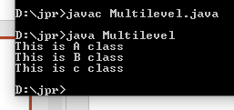

Slide 24
Example.
WAP to demonstrate use of constructor execution.
Class A
Class B
Class C

Slide 25
class A
{
A()
{
System.out.println("This is A class");
}
}
class B extends A
{
B()
{
System.out.println("This is B class");
}
}
class C extends B
{
C()
{
System.out.println("This is c class");
}
}
class MultilevelCon
{
public static void main(String args[])
{
C obj=new C();
}
}

Slide 26
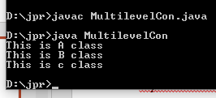

Slide 27
Example of Multilevel Inheritance
WAP to implement Multilevel Inheritance
Class square
Length , area()
Class Rectangle
Breadth , rectarea()
Class Box
Height , volume()

Slide 28
Overloading

Slide 29
Constructor Overloading
It means to define various constructor but with different signature.
When a class contains more than one constructor ,it is known as constructor overloading
When an object is created ,one of the constructor is executed depending on the order ,number & type of argument.

Slide 30
Syntax:-
class A
{
A( )
{
//body
}
A(int a)
{
//body
}
A(int a,int b)
{
//body
}

Slide 31
//constructor overloading
//Multiple constructor
class overload
{
int a,b;
overload()
{
a=0;
b=0;
}
overload(int x,int y)
{
a=x;
b=y;
}
void display()
{
System.out.println("a="+a+"\t"+"b="+b);
}
public static void main(String args[])
{
overload c1=new overload();
overload c2=new overload(2,3);
c1.display();
c2.display();
}
}

Slide 32


Slide 33
//constructor overloading
//Multiple constructor
import java.io.*;
class overload2
{
int len,breadth;
overload2()
{
len=0;
breadth=0;
}
overload2(int x)
{
len=breadth=x;
}
overload2(int x,int y)
{
len=x;
breadth=y;
}
int volume()
{
return len*breadth;
}
public static void main(String args[])
{
overload2 c1=new overload2();
overload2 c2=new overload2(2);
overload2 c3=new overload2(2,3);
int vol=c1.volume();
System.out.println("volume="+vol);
System.out.println("volume="+c2.volume());
System.out.println("volume="+c3.volume());
}
}

Slide 34
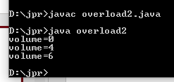

Slide 35
Method Overloading
Method Overloading means to define different methods with the same name but different parameters lists and different definitions.
It is used when objects are required to perform similar task but using different input parameters that may vary either in number or type of arguments.
Overloaded methods may have different return types.
It is a way of achieving polymorphism in java.

Slide 36
Syntax:-
class a
{
public void draw(int i)
{
//body
}
public void draw(double f)
{
//body
}
public void draw(int i,double f)
{
//body
}

Slide 37
//Method overloading
/* Define a class having overloaded method area() to calculate and display of square and rectangle.*/
class overloadM
{
int len,breadth,side;
void area(int s)
{
side=s;
int area1=side*side;
System.out.println("Area of square:"+area1);
}
void area(int l,int b)
{
len=l;
breadth=b;
int area2=len*breadth;
System.out.println("Area of rectangle:"+area2);
}
public static void main(String args[])
{
overloadM c1=new overloadM();
c1.area(2);
c1.area(3,3);
}
}

Slide 38


Slide 39
Method Overriding
In a class hierarchy, when a method in a subclass has same name & type as method in a superclass then method in a sub class is said to be overriding the method in a super class.
When an overridden method is called within a sub class it will always refer to the method define by the sub class and method in a superclass will be hidden.
But if we want to call the superclass method (overridden method), then we must includes super () in the subclass constructor.

Slide 40
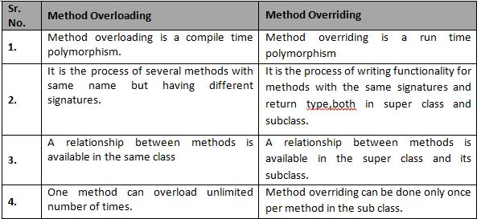
Differentiate between method overloading and method overriding.

Slide 41
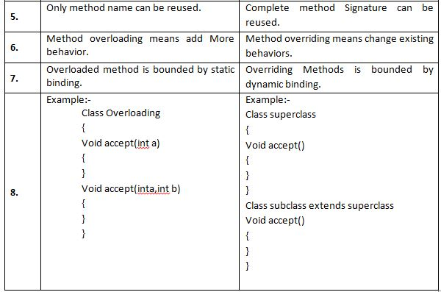

Slide 42
class A
{
int i,j;
A()
{
i=11;
j=12;
}
void show()
{
System.out.println("i="+i+" j="+j);
}
}
class B extends A
{
int k;
B()
{
super();
k=13;
}
void show()
{
super.show();
System.out.println("k="+k);
}
}

Slide 43

class Overriding
{
public static void main(String args[])
{
B obj=new B();
obj.show();
}
}

Slide 44
class A
{
void show()
{
System.out.println("The base method");
}
}
class B extends A
{
void show()
{
super.show();
System.out.println("Derived class method");
}
}
class Overriding1
{
public static void main(String args[])
{
B obj=new B();
obj.show();
}
}

Slide 45
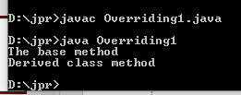

Slide 46
Use of super keyword
The First use of super keyword
It is use to access the members of the superclass in a subclass
Unlike the this keyword, the super keyword cannot be used to refer to the current object of a class ,but instead used to invoke the overridden method and hidden variable.
We can declare a field in a sub class with the same name as provided in the superclass.In such case the field in the super class cannot be access by their names in the subclass,since they have same name.

Slide 47
To solve this problem ,super keyword is used in the sub class to refer to the super class members from sub class.
Synatx
super.member;
i.e member can be instance variable or method
The second use of super keyword in java is to call super class constructor in the subclass.
Syntax
super(parameter list);

Slide 48
Characteristic of super()or subclass constructor
Super may only be used with in a subclass constructor
The call to superclass constructor must appear as the first statement with in subclass constructor.
The parameter in the super call must match the order and type of the instance variable in the super class.

Slide 49
Constructor Execution
When class hierarchy is created ,then constructors are called in order from superclass to subclass.
As super is first statement executed in subclass constructor , is same wheather or not super() is used.
If super keyword is not used then default constructor of each superclass is executed.

Slide 50
//Use of super to access the immediate parent class member(instance variable)
class A
{
int a=10;
}
class B extends A
{
int a=20;
void show()
{
System.out.println("a in super class: "+super.a);
System.out.println("a in sub class: "+a);
}
}
class super1
{
public static void main(String args[])
{
B obj=new B();
obj.show();
}
}

Slide 51
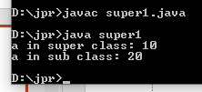

Slide 52
//Use of super to invoke the method of immediate parent class(method overriding)
class A
{
void show()
{
System.out.println("super class:A ");
}
}
class B extends A
{
void show()
{
super.show();
System.out.println("sub class:B ");
}
}
class super2
{
public static void main(String args[])
{
B obj=new B();
obj.show();
}
}

Slide 53


Slide 54
//Use of super to invoke the base constructor
class A
{
A()
{
System.out.println("Constructor of class A");
}
}
class B extends A
{
B()
{
//super();
System.out.println("Constructor of class B");
}
}
class super3
{
public static void main(String args[])
{
B obj=new B();
}
}

Slide 55


Slide 56
//Use of super to invoke the base constructor(parameterized)
class A
{
int a;
A(int z)
{
a=z;
System.out.println("Constructor of class A:"+a);
}
}
class B extends A
{
int b;
B(int x,int y)
{
super(x);
b=y;
System.out.println("Constructor of class B:"+b);
}
}
class super4
{
public static void main(String args[])
{
B obj=new B(10,20);
}
}

Slide 57


Slide 58
Example.
WAP to demonstrate use of constructor execution.
Class A
Class B
Class C

Slide 59
Method Overriding
In a class hierarchy, when a method in a subclass has same name & type as method in a superclass then method in a sub class is said to be overriding the method in a super class.
When an overridden method is called within a sub class it will always refer to the method define by the sub class and method in a superclass will be hidden.
But if we want to call the superclass method (overridden method), then we must includes super () in the subclass constructor.

Slide 60
Differentiate between method overloading and method overriding.

Slide 62
Final Keyword
Final keywords are used for three purposes:-
It is used to prevent method overriding.
It is used to prevent inheritance.
It is used to declare a variable as a constant.

Slide 63
Final Keyword
Final keywords are used for three purposes:-
It is used to prevent method overriding.
It is used to prevent inheritance.
It is used to declare a variable as a constant.

Slide 64
class A
{
final void show()
{
System.out.println("Invokes superclass");
}
}
class B extends A
{
void show()
{
System.out.println("Invokes subclass method");
}
}
class final1
{
public static void main(String args[])
{
B obj=new B();
obj.show();
}
}

Slide 65
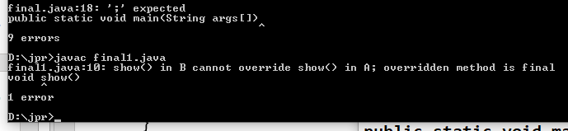

Slide 66
final class A
{
void show()
{
System.out.println("Invokes superclass");
}
}
class B extends A
{
void show()
{
System.out.println("Invokes subclass method");
}
}
class final2
{
public static void main(String args[])
{
B obj=new B();
obj.show();
}
}

Slide 67
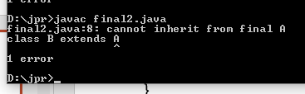

Slide 68
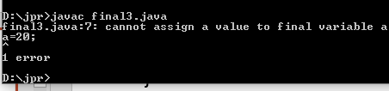
class final3
{
public static void main(String args[])
{
final int a=10;
System.out.println("a="+a);
a=20;
System.out.println("a="+a);
}
}

Slide 69
Dynamic Dispatch method
It is a mechanism by which a call to an overridden method is resolved at run time rather than compile time.
In this, overridden method is called through the reference variable of superclass.
When overridden method is called, java determines which version of that method to execute based on the type of the object being referred to at the time of call occurs.
i.e. determination of the method to be called is based on the object being referred to by the reference variable.
Hence this determination is done at runtime.
Hence Dynamic dispatch method implements run time polymorphism i.e. Virtual Function in C++.

Slide 70
class A
{
void show()
{
System.out.println("A in superclass");
}
}
class B extends A
{
void show()
{
System.out.println("B in subclass");
}
}
class C extends B
{
void show()
{
System.out.println("C in subclass");
}
}

Slide 71
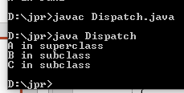
class Dispatch
{
public static void main(String args[])
{
A obj1=new A();
B obj2=new B();
C obj3=new C();
A r;
r=obj1;
r.show();
r=obj2;
r.show();
r=obj3;
r.show();
}
}

Slide 72
Abstract class & Methods

Slide 73
Abstract class & Methods
Sometimes when we want to create a superclass that only defines generalized form that will be shared by all of its subclasses, leaving it to each subclass to fills in a details i.e. superclass is unable to create a meaningful implementation for a method. Hence java provide the solution for this problem for declaring method as abstract.

Slide 74
Abstract Methods
An abstract method is a method that is declared without an implementation.
Syntax:-
abstract returntype method_name(parameter);
Abstract methods are known as subclass responsibility because they have no implementation specified in a superclass.

Slide 75
Rules or Features of abstract method
Method declared as abstract does not have actual code.
Method must be preceded by keyword abstract.
Abstract method must be overridden in subclass of the class which contain abstract method.
Method must end with semicolon (;).
Method should not have body.

Slide 76
Abstract Class:-
A class containing one or more abstract method has to be declared as an abstract class.
To declare class abstract precedes class with keyword abstract.
Syntax:-
abstract class class_name
{
-------------
abstract returntype method_name(parameter list);
-------------
}

Slide 77
Abstract class cannot be instantiated i.e. it does not allow to create object of the abstract class. But only reference variable can be created.
We cannot declared abstract constructor or abstract methods.
A subclass of abstract class must override abstract method of superclass otherwise subclass must be declared as abstract.

Slide 78
abstract class A
{
abstract void fun1();
void fun2()
{
System.out.println("A in fun2");
}
}
class B extends A
{
void fun1()
{
System.out.println("B in fun1");
}
}
class C extends A
{
void fun1()
{
System.out.println("C in fun1");
}
}

Slide 79
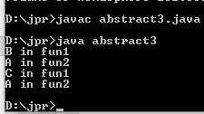
class abstract3
{
public static void main(String args[])
{
//A a=new A();
B b=new B();
C c=new C();
//a.fun2();
b.fun1();
b.fun2();
c.fun1();
c.fun2();
}
}

Slide 80
Example
Abstract class shape
dim1,dim2,dis(),abstract area()
Class Rectangle
getd(),area()
Class triangle
getd(),area()

Slide 81
abstract class shape
{
double dim1,dim2,area1;
void dis()
{
System.out.println("dim1="+dim1);
System.out.println("dim2="+dim2);
}
abstract void area();
}
class Triangle extends shape
{
void getd(double a,double b)
{
dim1=a;
dim2=b;
}
void area()
{
area1=(0.5*dim1*dim2);
System.out.println("Area of Triangle="+area1);
}
}

Slide 82
class Rectangle extends shape
{
void getd(double a,double b)
{
dim1=a;
dim2=b;
}
void area()
{
area1=(dim1*dim2);
System.out.println("Area of Triangle="+area1);
}
}
class abstract1
{
public static void main(String args[])
{
Rectangle r=new Rectangle();
Triangle t=new Triangle();
shape s;
s=r;
r.getd(4,2);
r.area();
r.dis();
s=t;
t.getd(3,5);
t.area();
t.dis();
}
}

Slide 83
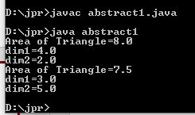

Slide 84
abstract class volume
{
final float pi=3.14f;
protected int r;
protected float v;
abstract float Disvol();
}
class sphere extends volume
{
float Disvol()
{
v=(4*pi*r*r*r)/3;
return(v);
}
}
class Hemisphere extends volume
{
float Disvol()
{
v=(2*pi*r*r*r)/3;
return(v);
}
}

Slide 85

class abstract2
{
public static void main(String args[])
{
Hemisphere h=new Hemisphere();
sphere s=new sphere();
s.r=5;
h.r=5;
System.out.println("volume of sphere="+s.Disvol());
System.out.println("volume of Hemisphere="+h.Disvol());
}
}

Slide 86
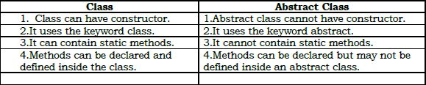
Compare class and abstract class

Slide 87
Static Members

Slide 88
Static Members
The variables & method defined in the class are called as instance variable & instance method because every time an object is created a new copy of each of them & access by using object.
When we want to define a member that is common to all the object & accessed without using particular object i.e. member belongs to the class as whole, then such members can be define as static.

Slide 89
Static Variables:-
Static variables are used when we want to have variable common to all instances of a class.
Syntax for declaring static members:-
static datatype variablename;
For Ex.:- To have a variable that could keep a count of how many object of class have been created.

Slide 90
Java provide a special construct that is used to initialize static variables known as static initializer or static block.
Syntax:-
static
{
static datatype variable = value;
}
Static variable will be created when class is loaded & JVM automatically calls static initializer which assigns some value to the variable & then it creates object.

Slide 91
2) Static Methods
Like static variables, static methods can be called without using the object.
Syntax:-
static returntype methodname(parameters)
{
//body;
}

Slide 92
Static methods are called by using class names.
Syntax:-
classname.methodname(parameter);
Static method can call only other static method.
They can only access static data.
They cannot refer to this or super keyword.

Slide 93
Characteristics of Static Members.
Static member are always preceded by keyword static.
Static members are called using classname.
Static methods can only call other static method.
Static method can only access static data.
They cannot refer to this or super keyword in anyway.

Slide 94
Static method can be called without using object.
The members that are declaring as static are associated with class itself rather than individual object.
Static initializer is automatically called, which assign some value to the variable & then it creates object of it.
Static block code execute only once when class is loaded.
Static members are independent of object. So they can be called before creation of object of class.

Slide 95

class stat
{
int p,q;
static int r;
static
{
System.out.println("static block call");
r=10;
}
public static void main(String args[])
{
stat ob=new stat();
}
}

Slide 96
class stat1
{
static int count;
stat1()
{
++count;
}
static
{
System.out.println("static block called");
count=0;
}
static void display()
{
System.out.println("object created="+count);
}
public static void main(String args[])
{
stat1.display();
stat1 ob1=new stat1();
stat1 ob2=new stat1();
stat1 ob3=new stat1();
stat1.display();
}
}

Slide 97
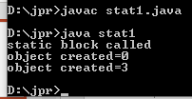

Slide 98
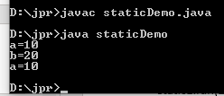
class static1
{
static int a=10;
static void fun(int b)
{
System.out.println("b="+b);
System.out.println("a="+a);
}
}
class staticDemo
{
public static void main(String args[])
{
System.out.println("a="+static1.a);
static1.fun(20);
}
}

Slide 99
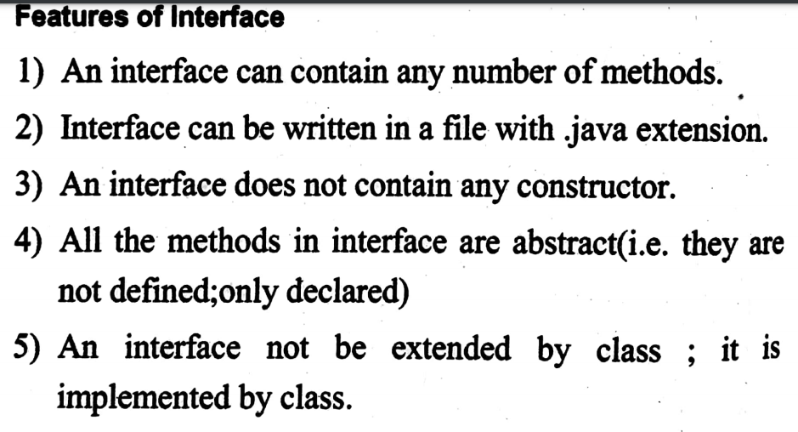
Interface

Slide 100
Features of interface.
I] Interface Implementation:-
Once an interface is define, one or more class can implement it.
Interface are used as super class, whose properties are inherited by classes.

Slide 101
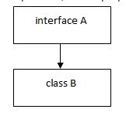
Syntax:-
interface A
{
//body
}
Class B implements A
{
//body
}

Slide 102
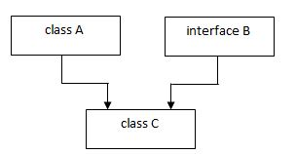
Syntax:-
class A
{
//body
}
interface B
{
//body
}
class C extends A implements B
{
//body
}

Slide 103
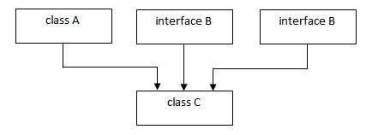
Syntax:-
class A
{
//body
}
interface B
{
//body
}
interface C
{
//body
}
class D extends A implements B,C
{
//body
}
C
D

Slide 104
II] Multiple Interface Implementing:-
A class may implements more than one interface.
When more than one interface implements by a class then all interface must be separated by a comma (,).

Slide 105
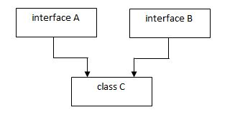
Syntax:-
interface A
{
//body
}
interface B
{
//body
}
class C implements A,B
{
//body
}

Slide 106
III] Extending Interface:-
When one interface inherits another interface then they uses keyword extends.
When interface are extends to another interface then this sub interface can’t define the method declare in a super interface. Therefore it is the responsibility of another class that implements interface to define the method of the interface.

Slide 107
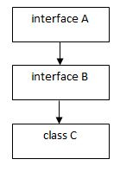
Syntax:-
interface A
{
//body
}
interface B extends A
{
//body
}
class C implements B
{
//body
}

Slide 108
class A
{
void show()
{
System.out.println("In class A");
}
}
interface B
{
void display();
}
class C extends A implements B
{
public void display()
{
System.out.println("In class B");
}
}
class interface1
{
public static void main(String args[])
{
C obj=new C();
obj.show();
obj.display();
}
}

Slide 109


Slide 110
//Multiple Interface Implementation
interface A
{
void show();
}
interface B
{
void display();
}
class C implements A,B
{
public void show()
{
System.out.println("In class C1");
}
public void display()
{
System.out.println("In class C2");
}
}
class interface2
{
public static void main(String args[])
{
C obj=new C();
obj.show();
obj.display();
}
}

Slide 111


Slide 112
Example
Write a program to implement following inhertance.
Interface Exam
per_cal()
Class Student
name,roll,mark1,mark2
Class Result
dis()

Slide 113
interface Exam
{
void per_cal();
}
class student
{
String name;
int roll,mark1,mark2;
student(String n,int r,int m1,int m2)
{
name=n;
roll=r;
mark1=m1;
mark2=m2;
}
}
class Result extends student implements Exam
{
Result(String n,int r,int m1,int m2)
{
super(n,r,m1,m2);
}
void dis()
{
System.out.println("Name="+name);
System.out.println("Roll No="+roll);
System.out.println("M1="+mark1);
System.out.println("M2="+mark2);
}

Slide 114
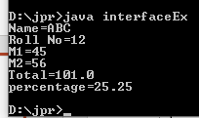
public void per_cal()
{
float total=mark1+mark2;
float per=(total/400)*100;
System.out.println("Total="+total);
System.out.println("percentage="+per);
}
}
class interfaceEx
{
public static void main(String args[])
{
Result obj=new Result("ABC",12,45,56);
obj.dis();
obj.per_cal();
}
}

Slide 115
Write a program to implement following inheritance.
Interface casette
acc_tittle()
Interface CD
acc()
Class Media
get(),put()

Slide 116
interface Casette
{
void acc_tittle();
}
interface CD
{
void acc();
}
class Media implements Casette,CD
{
String ty,t1;
void get(String type)
{
ty=type;
}
public void acc()
{
System.out.println("Type of CD="+ty);
}
void put(String tittle)
{
t1=tittle;
}
public void acc_tittle()
{
System.out.println("Tittle of CD="+t1);
}
}

Slide 117

class interfaceEx1
{
public static void main(String args[])
{
Media obj=new Media();
obj.get("video");
obj.put("ABC");
obj.acc();
obj.acc_tittle();
}
}

Slide 118
interface A
{
void show();
}
interface B extends A
{
void display();
}
class C implements B
{
public void show()
{
System.out.println("In class A");
}
public void display()
{
System.out.println("In class B");
}
}
class interfaceExtend
{
public static void main(String args[])
{
C obj=new C();
obj.show();
obj.display();
}
}

Slide 119


Slide 120
Accessing Implementations Through Interface References
Accessing Interface Methods
We can declare variables as object references that use an interface rather than a class type. Any instance of any class that implements the declared interface can be referred to by such a variable. When you call a method through one of these references, the correct version will be called based on the actual instance of the interface being referred to.
An interface reference variable have the knowledge of the method & variable declared by its instance.

Slide 121
Accessing interface variables
Interface can be used to declare a set of constant that will be available to any class that implements the interface.

Slide 122
//Accessing interface method using reference variable.
interface A
{
int m=10;
void show();
}
class B implements A
{
public void show()
{
System.out.println("m="+m);
System.out.println("interface method");
}
void dis()
{
System.out.println("subclass method");
}
}
class interfaceRef
{
public static void main(String args[])
{
A ref;
B obj=new B();
ref=obj;
ref.show();
obj.dis();
}
}

Slide 123
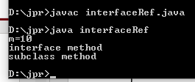

Slide 124
Implement following program through interface reference variable.
Interface VideoTape
title,length,available,show()
Class Movie
director,rating,store1()
dis1()
Class MusicVideo
Artist,category,store2()
dis2()

Slide 125
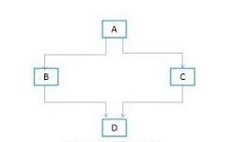
5)Hybrid Inheritance:It is a mix of two or more of the above types of inheritance
Ex

Slide 126
Syntax
class A
{
}
class B extends A
{
}
interface C extends A
{
}
class D extends B implements C
{
}

Slide 127
Package

Slide 128
need of Package
As all the java program are compiled and store in the namespace i.e. default.
As one namespace should not have more than one class with nickname but when we want to create more than one class which having the same name than we have to store it in different namespace, so that there should not be a name collision. For this purpose java uses this concept of package.
Another use of package is that suppose if we want to use classes from other program without actually copying them into program then it can be achieved by using package.

Slide 129
Define package
Package are the container for classes that are used to keep class namespace compartment wise.
Package is very similar to directory when two different directory may have number of files which have same name.
Package are used for grouping variety of class and interface together.
Syntax
package packagename;

Slide 130
Steps -Creation of package
Step1: To create a package simply include a package command as a first statement in a
java source file.
Syntax:-
package package_name ;
Eg:- package p1;
Step2:To define a class in package , declare as a public.
package p1;
public class A
{
// BODY
}

Slide 131
Steps 3:After declaring a class , create a sub directory p1 and compile create java.classfile and store in a same directory
Step 4:When package having more than one class is declare has a public and store this source file in that class_name [.java] extension.

Slide 132
Example
Consider class A which is contained in pack1 .
package Pack1;
public class A
{
public void display()
{
System.out.println (“ Method of pack1 “);
}
}
Save the source file by name A.java in directory pack1 and compile it.

Slide 133
Consider another package that is pack2.
package Pack2;
public class B
{
public void disp()
{
System.out.println(“Method of pack2 “);
}
}

Slide 134
Save the source file by name B.java in directory pack2 and compile it.
Now import class from other package.
import Pack1.A;
import Pack2.B;
class C
{
public static void main(String args[])
{
pack1.A Obj1=new Pack1.A();
pack2.B Obj2=new Pack2.B();
Obj1.display();
Obj2.disp();
}
}

Slide 135
effect from access specifier to the package
Access level modifier determine whether other classes can use particular field or invoke a particular method.
Data member and method can be declare with access specifier such as private, public and protected.
Public:-
Public modifier specify that the member can be visible to every layer .
Private:-
It specify that the member can be visible only the access within that class .

Slide 136
Protected:-
It specify that the member can only be access with it own package and sub-class of its class in another package .
Friendly (Default):-
It specify that the member can be visible to sub- class as well as other classs in the same package.

Slide 137
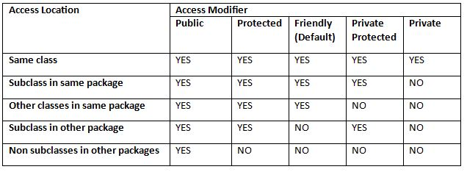

Slide 138
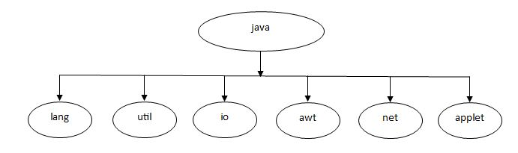
built in Package of java
Java API provides the large number of classes which are grouped together into different packages according to their functionality & use for specific application like looping, displaying GUI etc.

Slide 139
Different API packages are as follows :-
i) java.lang:-
This is the language support classes. There are the classes that Java compiler itself uses and therefore they are automatically imported. They include classes for primitive types, strings, math, functions threads and exceptions.
ii) java.util:-
This is the language utility classes such as vectors, hash tables, random numbers, data etc.

Slide 140
iii) java.io:-
This is the input/output support classes. They provide facility input/output of data and files. They include classes such as input string, output string, reader, writer.
iv) java.awt:-
It contain the set of classes for implementing graphical user interface. They include classes for window, buttons, lists, menus and so on.

Slide 141
v) java.net:-
It contains the classes for networking they include classes for communicating with local computers as well as with internet servers.
vi)java.applet:-
It contains the classes for creating and implementing applets.

Slide 142
Accessing an package
Package can be accessed either using fully qualified class name or by using a shortcut approach through the import statement.
User defined packages can be accessed through import statement. The import statement can be used to search a list of packages for a particular class.
The general form of import statement for searching a class or fully qualified class name approach is as follows:-
import pkg1 [.pkg2] [.pkg3].Classname;

Slide 143
The general form of Shortcut Approach is as follows:-
import packagename.*;
Drawback of the shortcut approach is that it is difficult to determine from which package a particular member take or use when large numbers of package are imported.
Advantage of shortcut approach is that there is no need of use large package names repeatedly in the programs.

Slide 144
Creating Package and accessing package in other program
package suwarna;
public class s1
{
public void show()
{
System.out.println("Package");
}
}
import suwarna.s1;
class s1m
{
public static void main (String args[])
{
s1 obj=new s1();
obj.show();
}
}

Slide 145
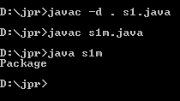

Slide 146
package suwarna;
public class s1
{
public void show()
{
System.out.println("Package");
}
}
package suwarna;
public class s2
{
public void show1()
{
System.out.println("second Package");
}
}

Slide 147
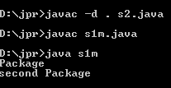
import suwarna.s1;
import suwarna.s2;
class s1m
{
public static void main (String args[])
{
suwarna.s1 obj=new suwarna.s1();
suwarna.s2 obj1=new suwarna.s2();
obj.show();
obj1.show1();
}
}

Slide 148
package pack3;
public class A3
{
public void dis()
{
System.out.println("class A3");
}
}
package pack4;
public class B3
{
public void dis2()
{
System.out.println("class B3");
}
}

Slide 149
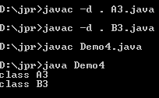
import pack3.A3;
import pack4.B3;
public class Demo4
{
public static void main(String args[])
{
A3 obj=new A3();
obj.dis();
B3 obj1=new B3();
obj1.dis2();
}
}

Slide 150
Static import
import static packagename.subpackagename.staticmembername;
Ex
import static java.lang.Math.*;

Slide 151
import static java.lang.Math.*;
class circle
{
public void area(double rad)
{
double a=PI*rad*rad;
System.out.println(“area="+a);
}
public static void main(String args[])
{
circle c=new circle();
c.area(4.0);
}
}

Slide 152

//static Import
class staticImport
{
public static void main(String args[])
{
double a=25;
double val=Math.sqrt(a);
System.out.println("Square root:"+a+" is "+val);
}
}

Slide 153
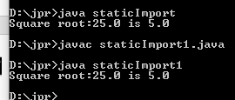
//static Import
import static java.lang.System.out;
import static java.lang.Math.sqrt;
class staticImport1
{
public static void main(String args[])
{
double a=25;
double val=sqrt(a);
out.println("Square root:"+a+" is "+val);
}
}

